Slide 1




Data Analysis In the Business Context
Applied Data Analysis Training
Data Analyst
PRESENTED BY
Ziad Ali
Mahmoud El-Desuky

Slide 2
Excel In The Business Context
Hotel Business Problem
A mid-sized hotel faces challenges in managing bookings from various channels, including Online Travel Agencies (OTAs), direct bookings through the hotel's website, and traditional travel agents. The hotel's management aims to better understand these financial impacts to optimize their channel strategy, reduce costs, and enhance profitability.
03

Slide 3
Hotel data analysis:
In this analysis, we will take a look at hotel reservations data to understand the patterns, trends, and challenges a hotel faces in managing its reservations from different sources. This analysis aims to improve the hotel's strategy in managing reservations and enhancing profitability.
Challenges:
The hotel faces challenges in managing bookings from multiple channels such as Online Travel Agencies (OTAs), direct bookings, and traditional travel agents.

Slide 4
questions:
How many reservations?
How many reservations are there based on the number of nights?
What is (total revenue, commissions and profits)?
What is the average revenue per booking?
What is the average booking each day?
What is seasonality and trends by quarters and months?
What is profit through channels?
What is the profit depending on room type?
Analysis:
Bookings data will be used to analyze financial operations and trends across different time periods according to the questions asked.
A variety of graphs and reports will be generated to illustrate the findings and trends discovered.

Slide 5
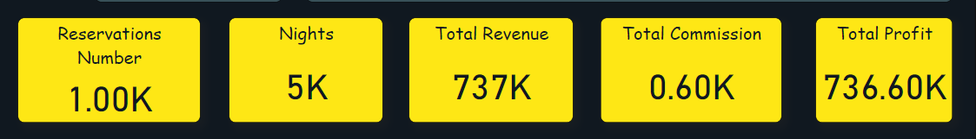
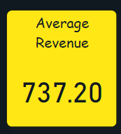
How many reservations?
How many reservations are there based on number of nights?
What is (total revenue, commissions and profits)?
What is the average revenue per booking?

Slide 6
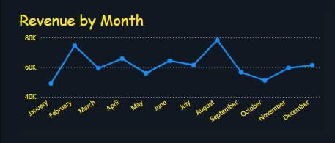
What is seasonality and trends by months?
Revenue by Month
description:
This graph shows an oscillating line with dots from January to December, indicating changes in revenue over the year.The Y axis represents revenue (in thousands).The X axis represents the months from January to December.
Notes:
Revenue ranges between 40K and 80K during the year.August shows the highest revenue among the months, followed by February.There is a clear fluctuation in revenue across months, with a notable decline in September and October.

Slide 7
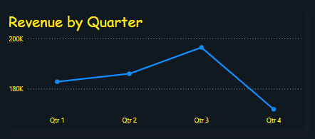
What is seasonality and trends by quarters?
Revenue by Quarter
description:
This graph displays a line with four dots, representing revenues for the first, second, third, and fourth quarters.The Y axis represents revenue (in thousands).The X axis represents the quartiles from the first to the fourth quartile.
Notes:
Revenues in the third quarter are the highest, followed by revenues in the second quarter.There is a significant decline in revenue in the fourth quarter compared to the third quarter.The first quarter shows the lowest revenue among the quarters.

Slide 8
Recommendations based on the analysis:
Increase focus on peak months:
Since August and February show the highest revenues, the hotel should invest more in marketing and promotions during these months to increase bookings and make the most of the high demand.

Slide 9
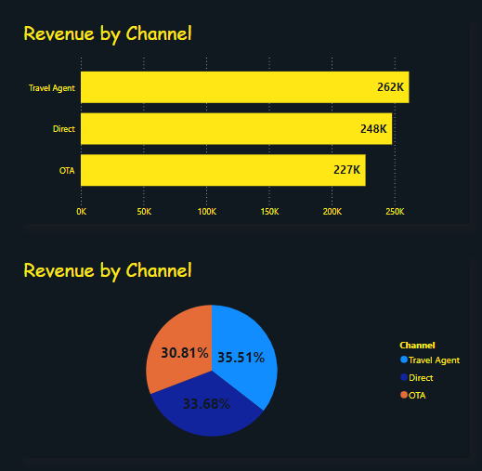
What is profit through channels?
Revenue by Channel
description:
This graph shows revenue from three channels: Travel Agents, Direct Bookings, and Online Travel Agencies (OTAs).Data is represented as horizontal bars, where the Y axis represents the different channels, and the X axis represents revenue (in thousands).
Notes:
Travel agencies generate the highest revenue of 262K.Direct bookings come in second with revenue of 248K.Online travel agencies generate the lowest revenue at 227K.

Slide 10
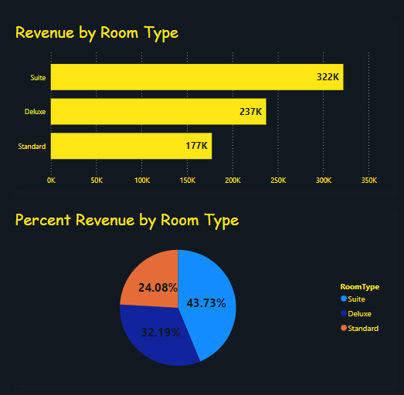
What is the profit depending on room type?
Revenues by room type
description:
This chart shows revenue by different room types: Suite, Deluxe, Standard.Data is represented as horizontal bars, where the Y axis represents different room types, and the X axis represents revenue (in thousands).
Notes:
Deluxe rooms (Suite) achieve the highest revenues at 322K.Deluxe rooms generate revenue of 237K.Standard rooms generate the lowest revenue at 177K.

Slide 11
Recommendations based on the analysis:
Strengthening partnerships with travel agencies:
Since travel agencies generate the highest revenues, the hotel should strengthen partnerships with them by offering special offers and lucrative commissions to attract more bookings through this channel.
Increased incentive for direct bookings:
Since direct bookings are second in terms of revenue, this channel can be enhanced by improving the booking experience on the website and offering exclusive discounts to customers who book directly.
Analyze and develop a strategy for dealing with online travel agencies:
Since online travel agencies generate less revenue, you should study the possible reasons for this and work to improve the relationship with them by providing competitive offers and improving the hotel’s visibility on their platforms.

Slide 12
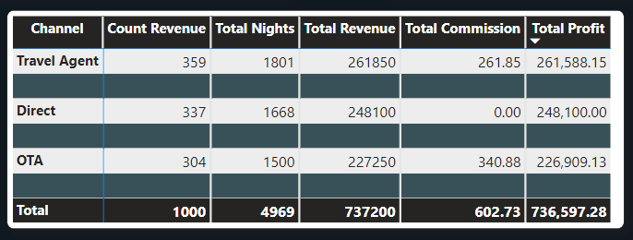
Travel channels and total revenues

Slide 13
Thanks
Ziad Ali
D A T A A N A L Y S T

